Slide 1
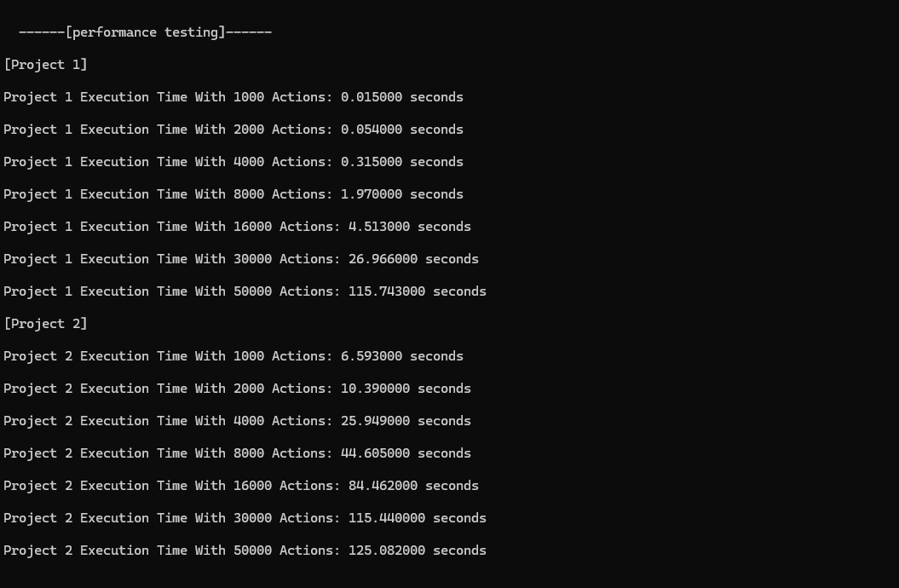

Assignment 1 – Database
Ben Dolliver #618797
https://github.com/Ben-Dolliver/KIT205-618797
Introduction
Conclusion
The Problem domain that I have decided is academic papers & authors. In the space of academic tracking papers and authors can become very complicated very quickly. Moreover, traditionally this Is tracked by name which can become very confusing trying to figure out if the J.Smith is the same J.Smith on 2 different papers. This problem domain is a many-many relationship since each author can have written many papers and a paper can be written by many authors. My program’s goal is to create a database of linked Papers and Authors. Within this program you are able to add new papers, authors, add authorship to a paper/author print all the papers an author has written, print all the authors of a specific paper and find specific papers/authors.
This project is particularly interesting for me because it could be expanded into many different usable applications that have not been done before. I take specific inspiration for google/google scholar, Initially I was inspired to design the program by the idea of how the internet was originally for research papers and through incremental development slowly transformed into what we have today
If I were to continue this project further, I would love to include a referencing structure for a chosen paper's links to other papers. Eventually this could be made into a directed graph of interlinked papers and authors which would be super interesting to see. Furthermore, alternative variables could be introduced like date and topic eventually this program could be made into its own website/search engine akin to google scholar or an AI program to interpret papers/write meta-papers.
Through completing this project, I developed a deeper understanding of how data structures and algorithms can be applied to solve real-world database problems involving large amounts of interconnected data. The project integrated concepts covered throughout the unit, including linked lists, binary search trees, hash tables, complexity analysis, and performance testing, while also providing opportunities to design and implement creative solutions.
The experimental testing demonstrated clear differences in scalability between the two database prototypes. In the linked-list implementation, the database was required to traverse nodes sequentially in order to locate specific authors and papers. While this approach performed adequately for small datasets, execution time increased rapidly as the dataset size grew due to repeated linear searches. In contrast, the hash-table implementation used hash functions to directly access records, significantly reducing lookup costs. Although the hash-table prototype introduced greater overhead initially, its runtime increased at a much slower rate for large datasets.
Both the theoretical complexity analysis and experimental results supported the conclusion that the hash-table-based database is the more scalable and efficient solution for large-scale data storage and retrieval. If the project were to be expanded further, the hash-table implementation would be the preferred architecture due to its superior search performance and improved scalability characteristics.
Data structures
Methodology & Results
For Project 1, I chose to implement a linked list of binary search trees, while for Project 2 I implemented a hash table of binary search trees. Both prototypes were designed to model the many-to-many relationship between research papers and authors while allowing comparison between different data structure approaches and their effect on performance and scalability.
Linked lists were suitable for the first prototype because they allow dynamic memory allocation and simple insertion of new records without requiring a fixed database size. Their structure is also straightforward to implement and traverse, making them useful for an initial database prototype.
Binary search trees (BSTs) were used to store relationships between authors and papers because they provide faster searching and insertion than sequential structures while also maintaining data in sorted order. This made them effective for managing and printing many-to-many relationships.
Hash tables were chosen for the second prototype because they significantly improve lookup performance. Instead of traversing records sequentially like linked lists, hash tables use hash functions to directly access data locations, providing much faster searching for large datasets. This made the second prototype more scalable and efficient as the amount of stored data increased.
Based on the coding logic the linked list implementation of the database will be forced to traverse the linked list node by node to reach the intended paper/author. This will start out quick but will escalate in time fast. The hash table implementation on the other hand can jump directly into the correct location. This will lead to slower times initially but will grow at a slower rate. The tested data supports this theory and if developing the project further I would rely on a hash table implementation rather than a linked list implementation
As we can see from the program’s performance testing project 1’s time taken is multiplying around 4-8x previous values time for each increment this starts out small but becomes large very quickly, this is very expensive scaling and indicates that it is an exponential complexity based on this test around O(n^4)
Based on project 2’s testing we can see that the initial value starts out large but seems to slow down this could either be a linear or logarithmic complexity if we were to keep running the program project 1 would overtake project 2 in time taken
References
https://www.geeksforgeeks.org/c/c-program-for-binary-search-tree/ https://www.geeksforgeeks.org/dsa/hash-table-data-structure/
https://www.youtube.com/watch?v=2Ti5yvumFTU&t=354s
KIT 205 & 107 Tutorials / Study

